Slide 1
The Battle of the Neighborhoods
Choosing The Neighborhood For Opening A Restaurant In
Los Angeles

Slide 2
Background Intruduction
Los Angeles is a very diverse city and it is one of the financial capitals of USA. So it's a good place to open a business, like a restaurant.
One of the most important things about opening a restaurant is to choose the right location.
Do some serious research on the target location is really helpful.
I will do the segmenting and clustering the neighborhoods of Los Angeles to explore and analyze the neighborhoods.
Based on these data analysis, people can choose which location is better for opening a restaurant in Los Angeles region.

Slide 3
Data Acquisition And Cleaning
I used the online Wikipedia web page (https://en.wikipedia.org/wiki/List_of_districts_and_neighborhoods_of_Los_Angeles) to get the neighborhoods of Los Angeles city.
I imported library of BeautifulSoup to clean the html file.
I imported nominatim to find the latitude and longitude of the corresponding neighborhood.
I imported geopy library and foium library for making a map.

Slide 4
Methodology
I choose K-means clustering as the model to analyze the data that obtained from Foursquare API.
K-means clustering is a type of unsupervised learning, which is used when you have unlabeled data.
The results can be used to help make a decision of open a restaurant assumptions.
Foursquare is a technology company that built a massive data set of location data. What is interesting about Foursquare is that they were very smart about building their data set.

Slide 5
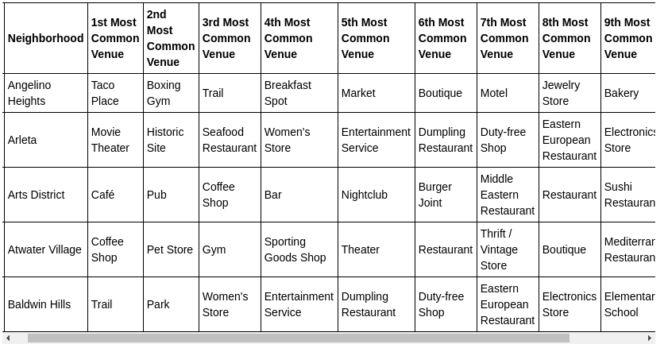
Results
I got the top 100 venues that are in each neighborhood within a radius of 500 meters.

Slide 6
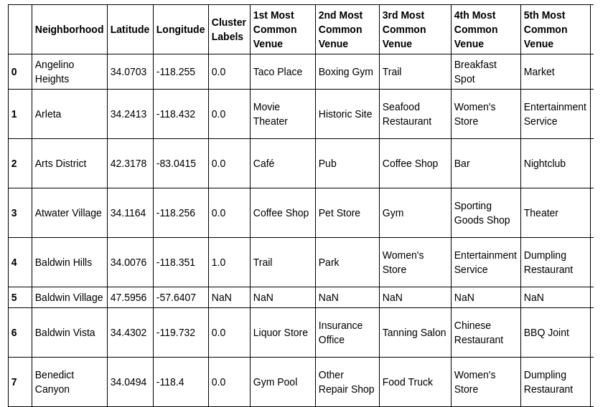
Results
I used K-means clustering algorithm to calculate the obtained venues data set.

Slide 7
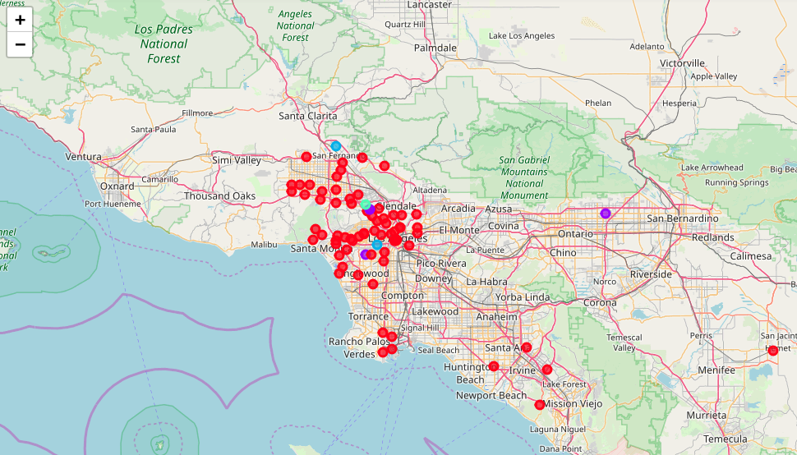
Results
I visualized the obtained clusters in a map.

Slide 8
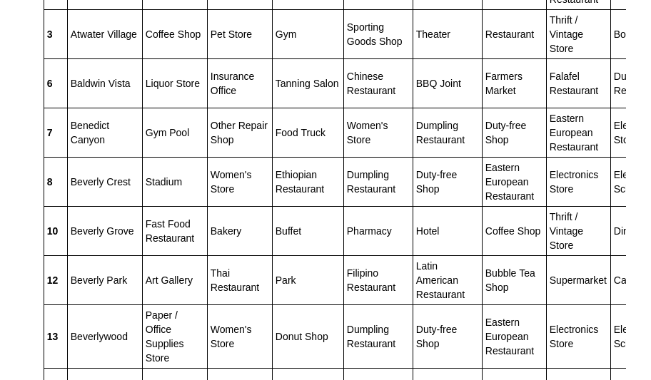
Discussion
In cluster 1 the diversity of the type of restaurant is significant.
People frequently to eat outside.
you have a wide range of choice of the type of restaurant.

Slide 9
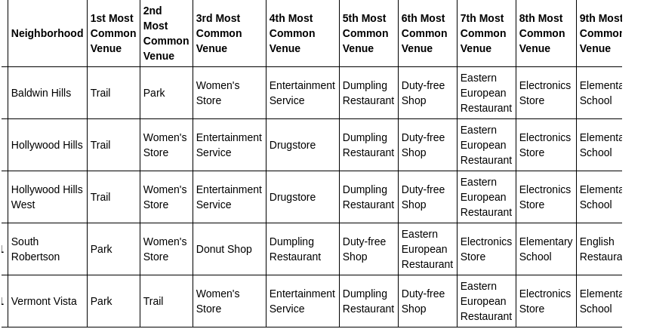
Discussion
In this cluster, nearly no restaurant in top 4 common venues.
For opening restaurant in these five neighborhoods will be dumpling restaurant or English restaurant.

Slide 10
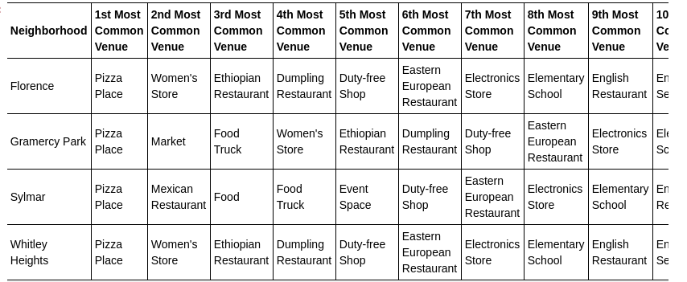
Discussion
In cluster 3, four neighborhoods were included. In these four neighborhoods, the first most common venues are all pizza place.
Opening a pizza place is a good suggestion.
Other kinds of restaurant is also be good choice.

Slide 11
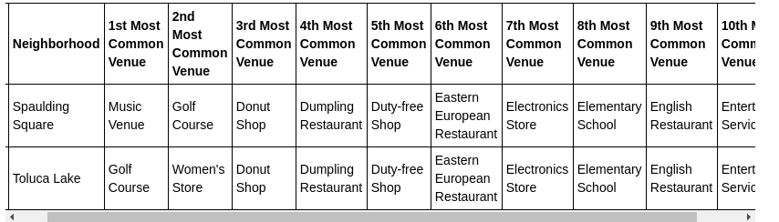
Discussion
In cluster 4, two neighborhoods were studied.
My suggestion for these places to open a restaurant is donut shop.

Slide 12
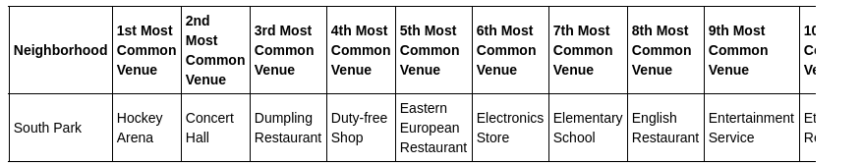
Discussion
In cluster 5, there are only one neighborhoods. There are different types of restaurant in this neighborhoods.
Opening a type of restaurant that already exist is a good idea.

Slide 13
Conclusion
I analyzed the neighborhoods of Los Angeles with data set that obtained from Foursquare API.
I chose k-mean clustering algorithm to built the model. And I visualized the results by creating a map.
The model that I made can be very useful in helping people choose how to open a certain type of restaurant in the better neighborhood
For each cluster, the venues showed the most common venues they visited recently. So we can decide what kind of restaurant we can open in certain place.

